Slide 1
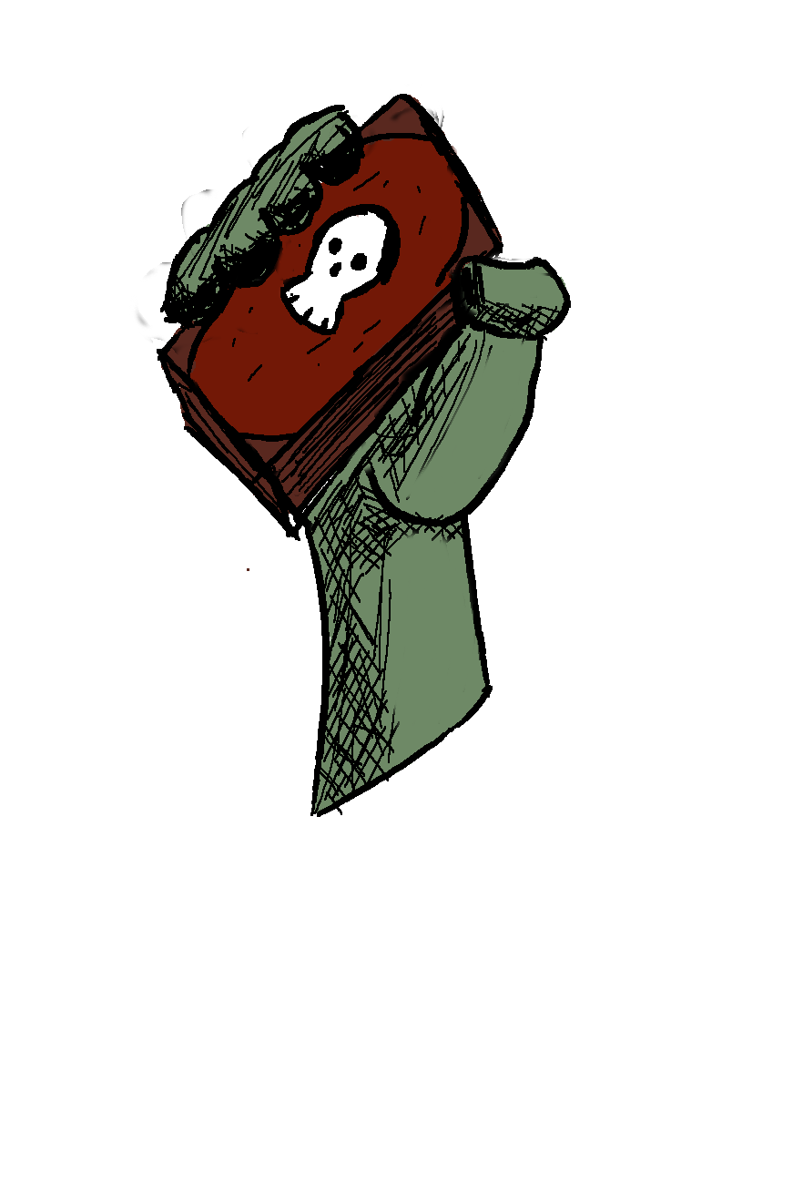
Deckromancy
A strategy card game by Sasha Greene

Slide 2
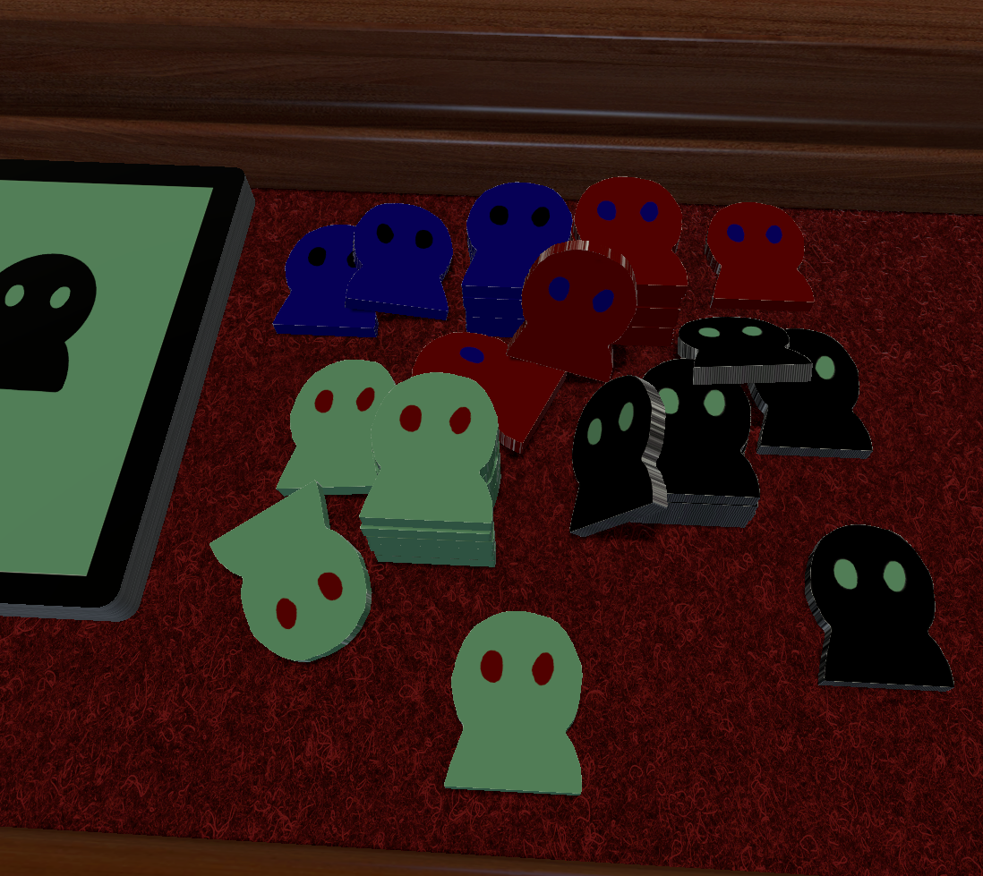
Core Concepts:
-The dark overlord has fallen to the forces of good and his followers are left scattered, with no leader and no direction.
-Players are all vying for control of the board, in order to proclaim themselves as the new overlord.
-Attrition Based card game with strategic elements and an rpg inspired combat system.
-Players will use the cards in their hand to build up their undead hordes and take over the locations on the map.
-Estimated play time 15-30 minutes/game
-Designed for 2-4 players(With a larger map, more players would be possible.)

Slide 3
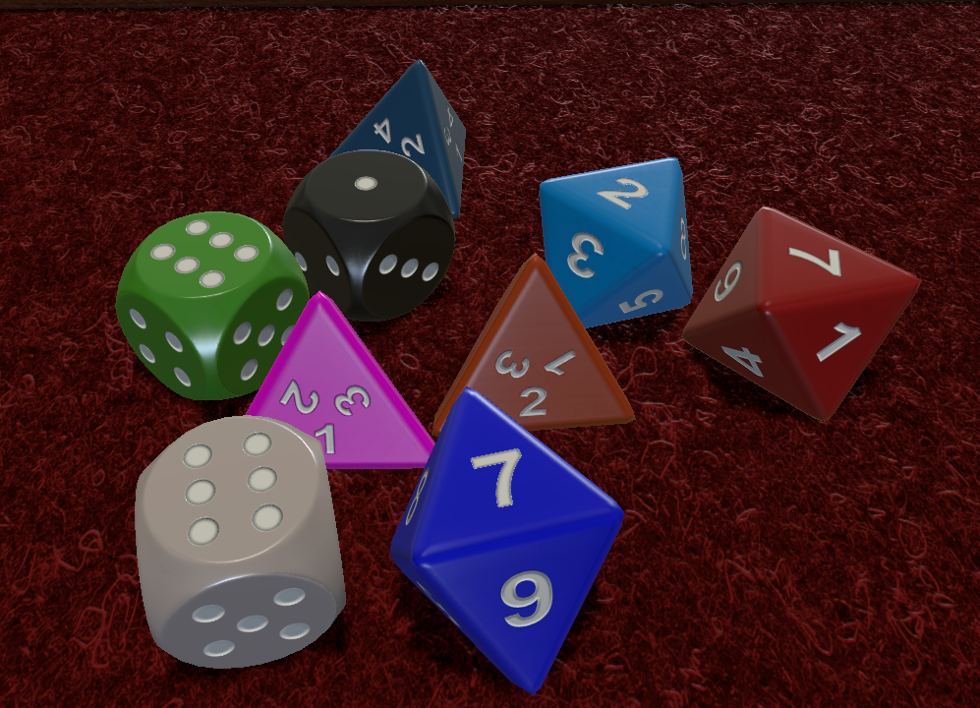
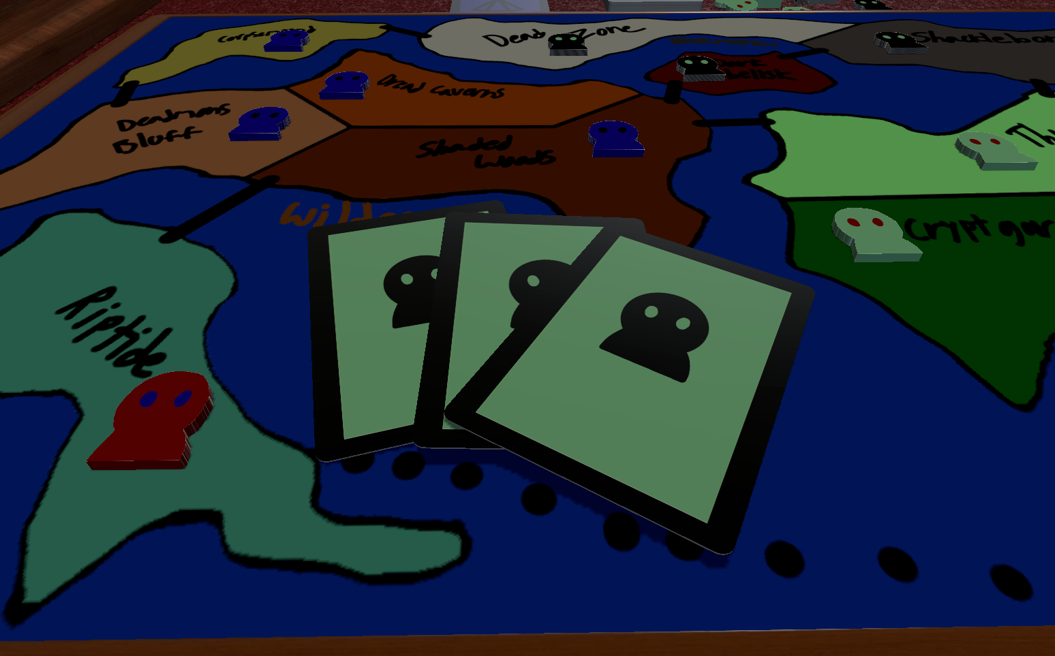
What you need to play
-Dice ranging from d2-d8(Initially)
-The 3 decks(Horde, Power, Location)
-A Map(Board)
-Health markers(not necessary but quite helpful in combat)
-Tokens to show ownership on the board.
-At least one friend(or random person if no friends.)

Slide 4
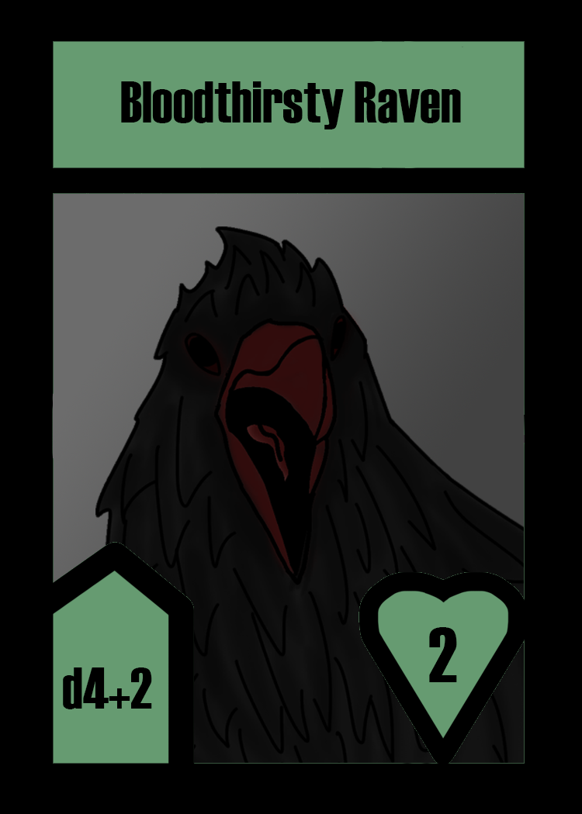

The card types:Horde
Front
Back
-These are the main fighting force of the game and are essential to victory.
-They will have a name
-They will have a damage amount.(displayed as number of dice and sides on those dice)
-They will have a health amount.(The heart)

Slide 5
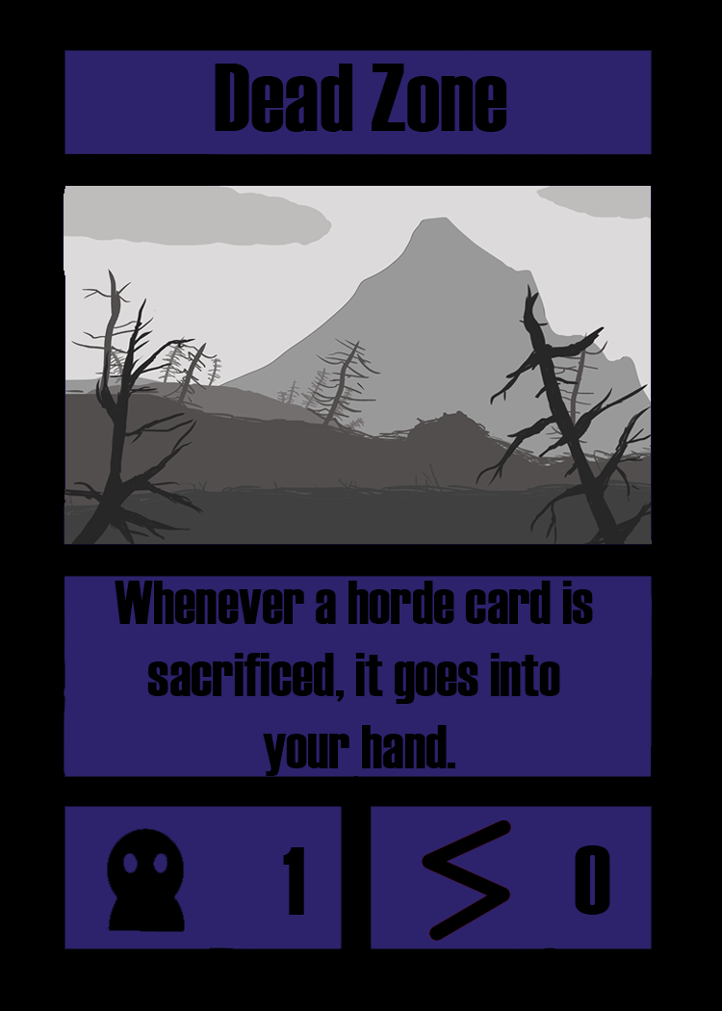
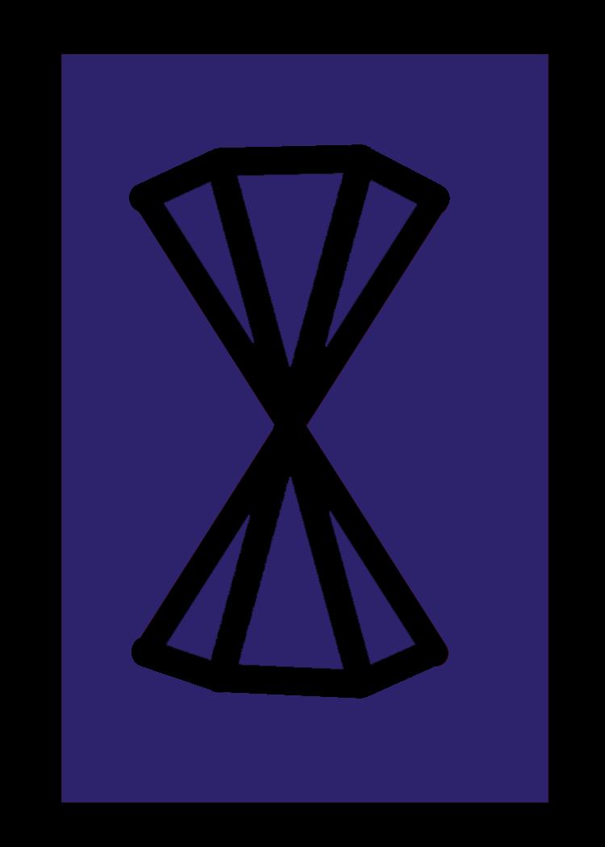
The card types:Location
-They will have a horde and a power value which affects your max hand size.
-They will display the name of the corresponding location on the board.
-They may offer bonuses such as board-wide horde buffs, or special abilities that players may use.
-This ability can not be used the turn that the location is acquired.
-Unless otherwise stated, these abilities can only be used once per turn.
When holding specific combos of locations, you may trigger a regional bonus.
Front
Back

Slide 6
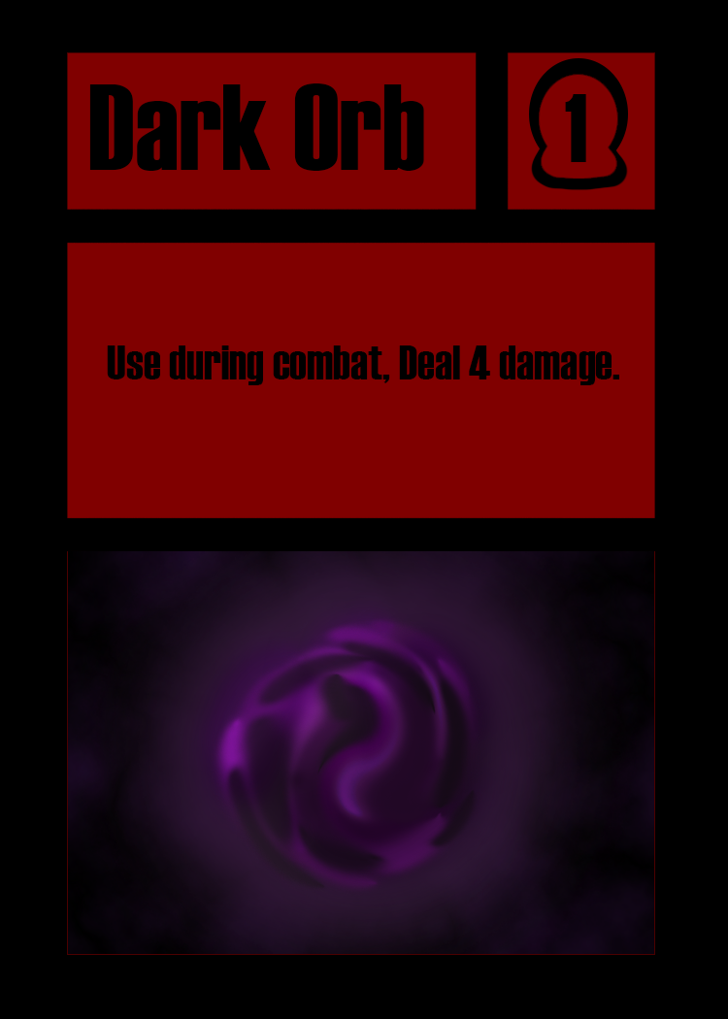

The card types:Power
Front
Back
-They will have an effect which could usually affects combat, but not always.
-They will display their name
-Can generally be played at any time(usually during combat though.)
-They may have a cost(but not always)-this amount of cards(horde or power) must be sacrificed in order to play the card.

Slide 7
Start of the game:
-Each player draws a random location card
-If these are adjacent in a 2 player match, both players redraw(Prevents first turn steamrolls)typically you will use a larger map for more players but with the current map adjacency is nearly impossible to avoid.
-Whoever has the lowest total hand size goes first, if it is a tie, flip a coin to determine first player.
-Your hand size is determined by the sum of the horde and power values shown on your location card.
-Combat usually doesn’t take place during the first couple of turns, as the players will want to take over as many locations as possible.

Slide 8
During a players turn:
-At the start of each turn, everyones location abilities refresh and the player whose taking their turn draws 2 horde and 2 power cards
-You may declare one combat per turn by default, it must be from one of your locations to an adjacent location, you may skip combat if you desire
-If victory is achieved during combat, you take that location card but you can't use its ability until next turn
-After Combat is concluded a player may end their turn. At this point they must discard down to their maximum hand size
-Play proceeds clockwise.

Slide 9
Combat:
1)Attacker declares their active horde(places a horde card)
2)Defender declares their active horde.
3)Both players roll dmg dice simultaneously.
4)both cards take damage shown on dice plus/minus modifiers
5)If a hordes health drops to 0, it is discarded and may be replaced with another one from the hand if defending, you may retreat at this point.
6)Attacker may end combat whenever dice are not rolling.
7)If the attacker has a horde still active after victory, it is discarded.

Slide 10
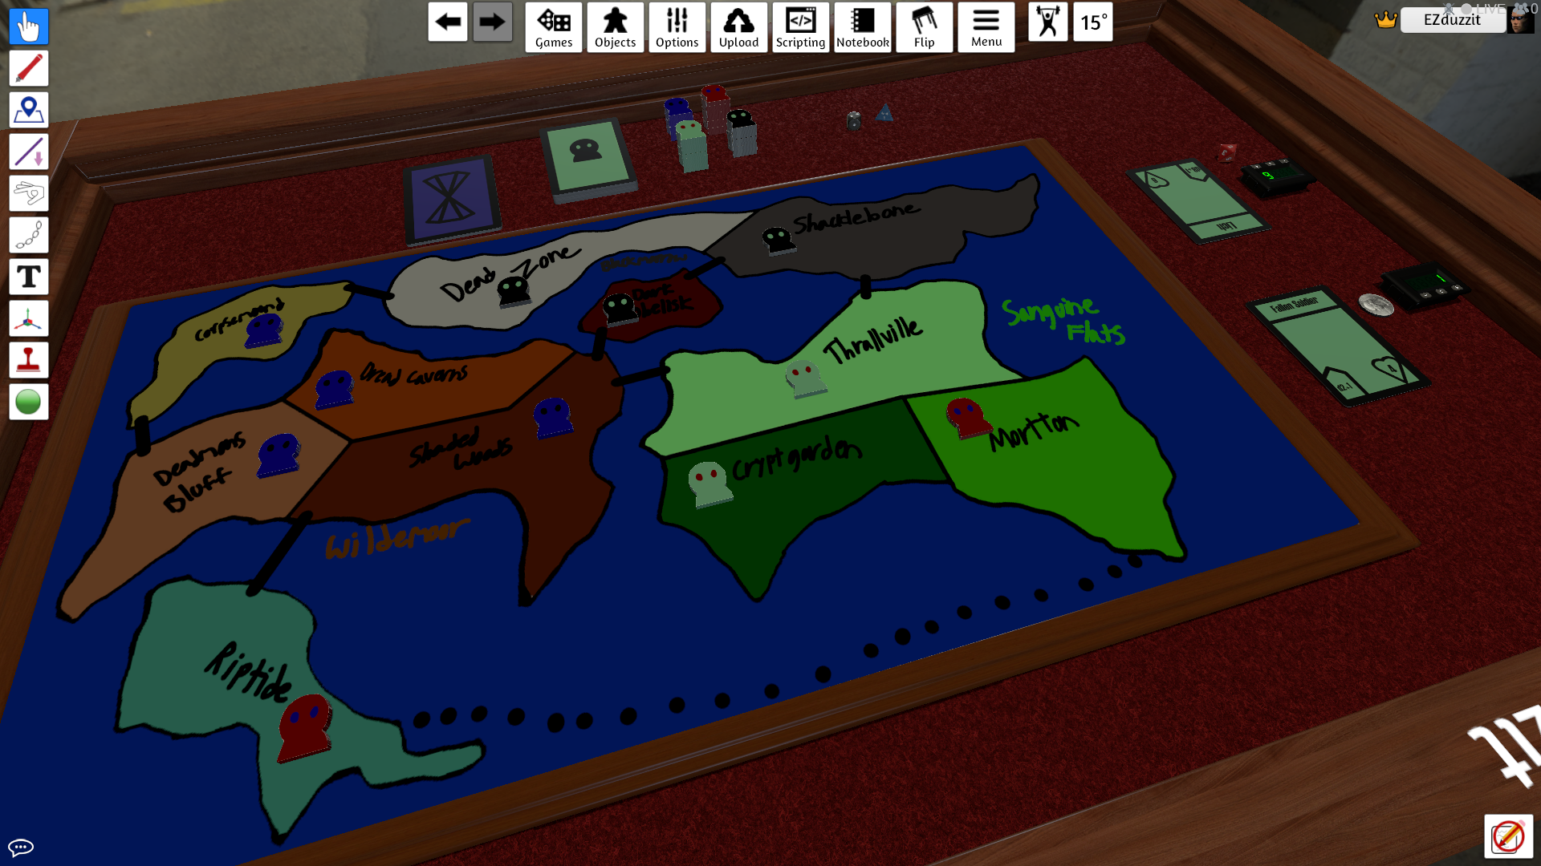
The game in action on tabletop simulator

Slide 11
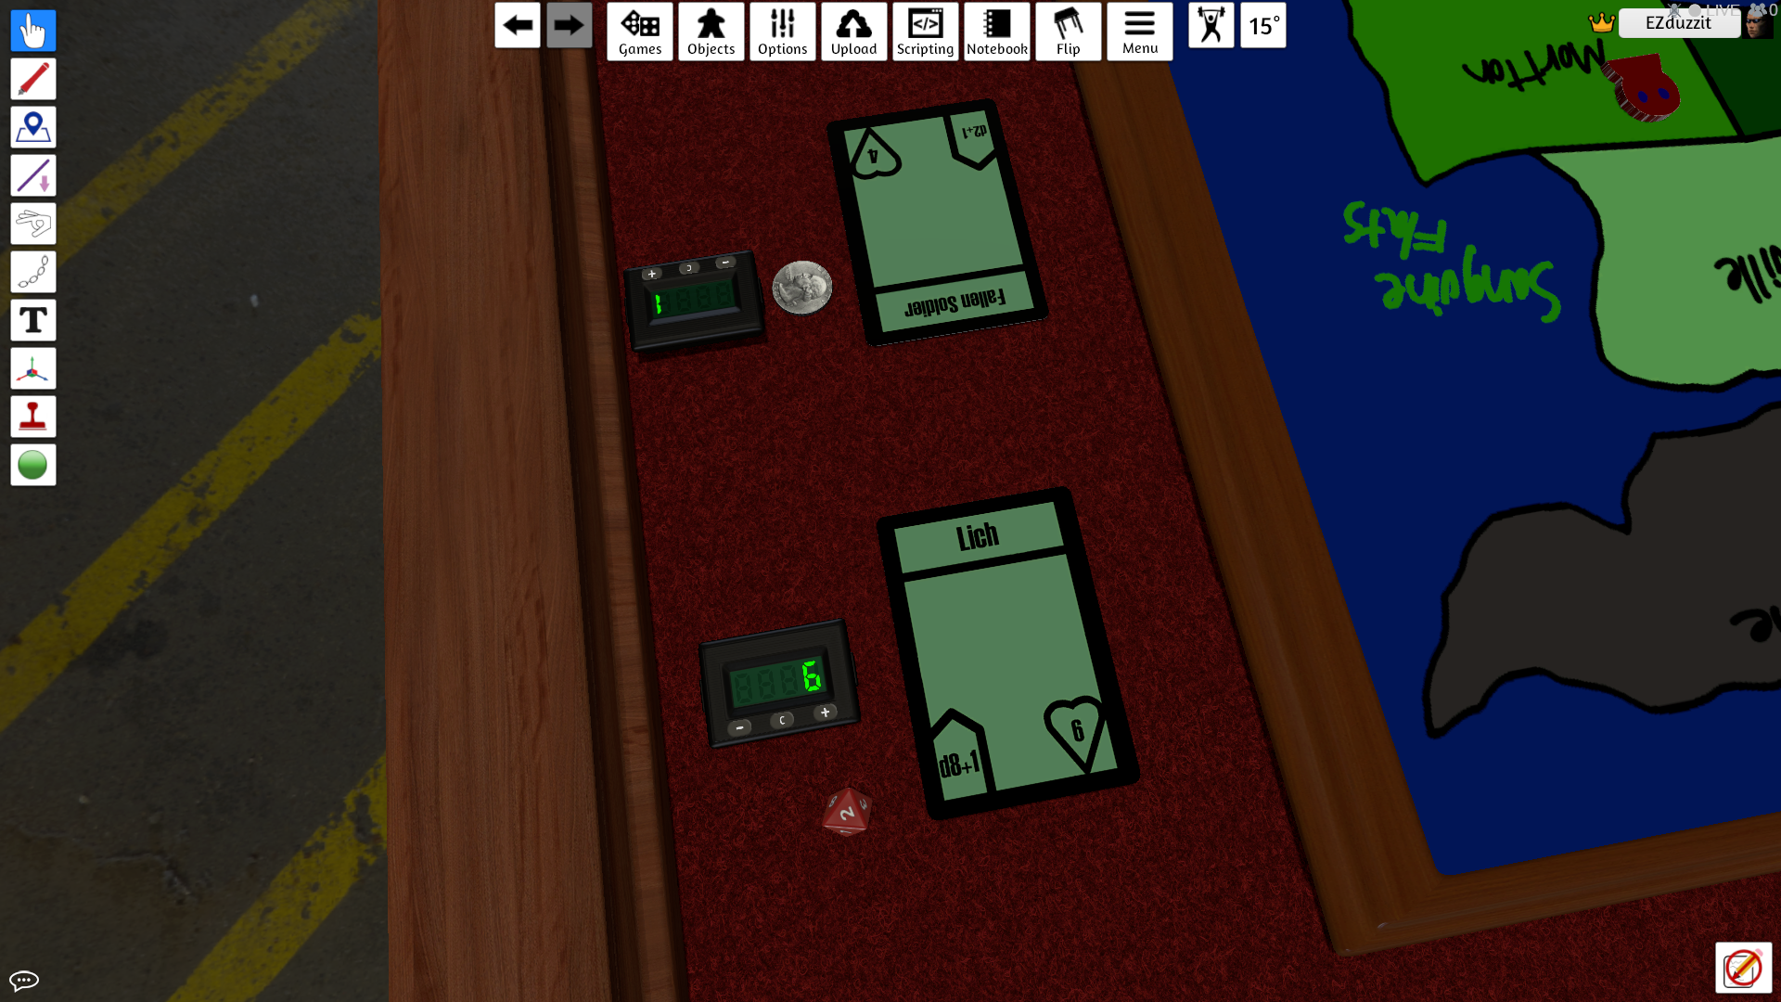
What combat looks like in TTS

